Slide 1
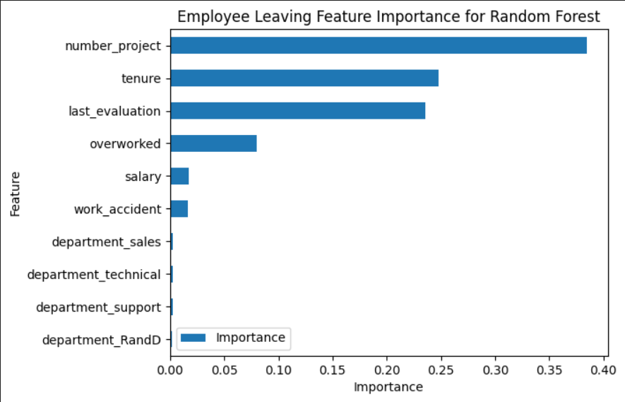
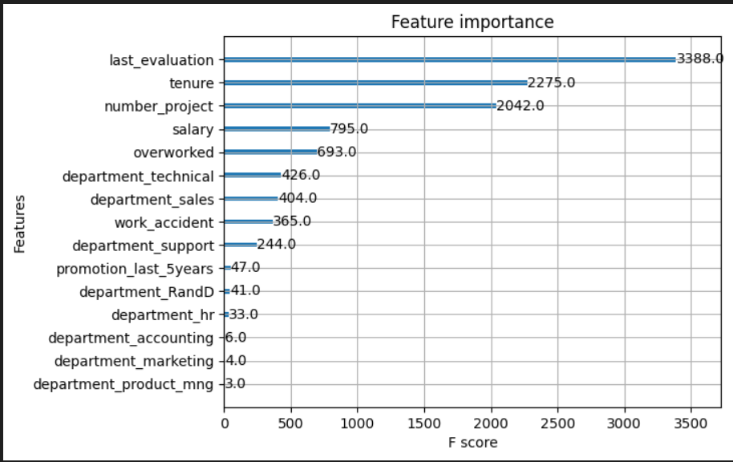
Salifort Motors
Employee Retention Project
Salifort Motors seeks to improve employee retention and answer the following question:
What’s likely to make the employee leave the company?
Since we are seeking a categorical variable, we can go thru a logistic regression or decision trees.
There were trained decision tree classifier, random forest and XGBoost classifier.
Based on the results its likely to use random forest or xgboost, due to its simmilar result and lightly better then decision tree.
Barplot above shows the most relevant variables: ‘number_project’, ‘tenure’, ‘last_evaluation’ and ‘overworked’, for the random fores model.
This models helps predict whether an employee is close to resign and identify which factors are most influential. This information helps the Salifort HR team to improve or implemet strategies to retain employees.
In the XGBoost model above, `last_evaluation`, `tenure`, `number_project`, `salary` and `overworked` have the highest importance. These variables are most helpful in predicting the outcome variable, `left`.
* Implement a cap on the number of projects that employees can simultaneously be in.
* Explore the possibility of promoting employees who have completed a minimum of four years with the company, or conduct further investigations to understand the dissatisfaction among employees with four years of tenure.
* Consider incentivizing employees for working extended hours or reevaluate the necessity of long working hours.
* Ensure that employees are well-informed about the company's policies regarding overtime pay. Clarify expectations regarding workload and time off.
* Issue open discussions at both company-wide and team levels to comprehend and address underlying issues in the company's work culture and work ambient.
* Reassess the evaluation criteria to ensure that high performance ratings are not solely reserved for employees who work exceptionally long hours. Adopt a more proportional approach to recognize and reward employees based on their contributions and efforts.

